Slide 1
R26-DS-010 · FINAL YEAR RESEARCH PROJECT — PROGRESS PRESENTATION II
Multimodal Computational Intelligence for Enhancing Caregiver Performance and Care Delivery
CareSense — a unified, web-based AI platform that detects caregiver stress, predicts patient falls, automates ADL documentation, and teaches sign language, evaluated as four independently rigorous modules.
MAIN SUPERVISOR
CO-SUPERVISOR
EXTERNAL SUPERVISOR
Prof. Samantha Thelijjagoda
Mr. Samadhi Rathnayake
Mr. Velu Sivakumar
SLIIT Faculty of Computing · Specialization: Data Science

Slide 2
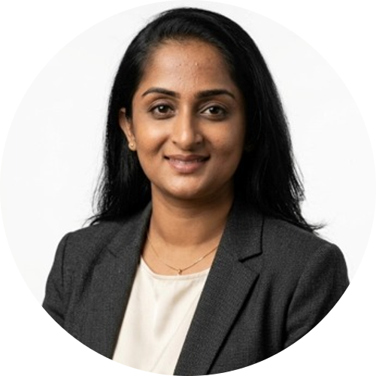
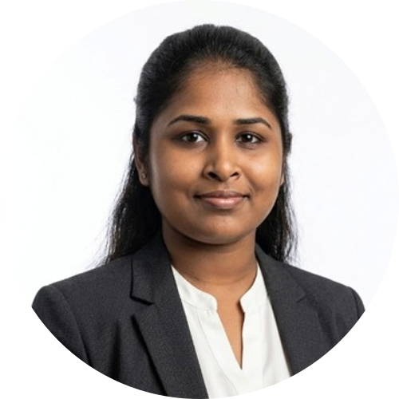
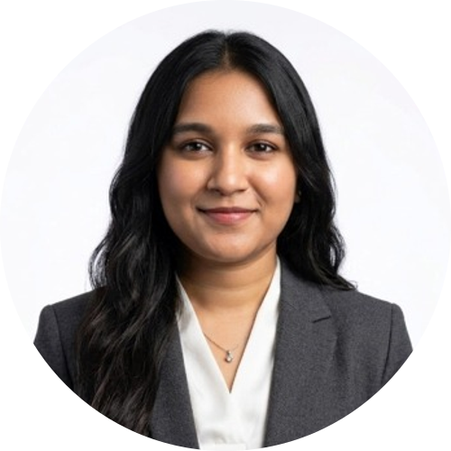
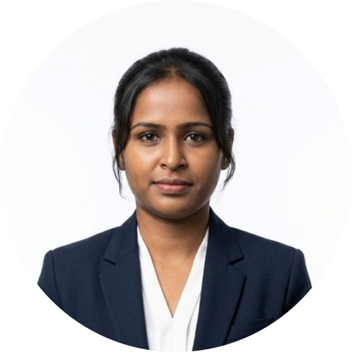
00 · TEAM
Team Members
COMPONENT 01
COMPONENT 02
Dayana Priyadharshani Kumar
Harishalinee Elangovan
IT22178640
IT22057488
AI-Assisted Caregiver Workforce Deterioration Detection and Adaptive Workload Redistribution
Edge-Enabled Skeletal Movement Analysis System for Real-Time Patient Observable Fall Risk Detection and Prediction
COMPONENT 03
COMPONENT 04
Vidursha Prabagaran
Kaushalya Nagenthraraja
IT22294098
IT22289384
Context-Aware Intelligent System for Automated ADL Extraction and Real-Time Documentation from Caregiver Voice Logs
Personalized Sign Language Tutoring System for Caregivers
R26-DS-010 | CareSense | SLIIT Faculty of Computing
2

Slide 3




00 · PANEL FEEDBACK
PP1 Comments — How We Addressed Them
Dayana Priyadharshani Kumar IT22178640 · Stress-Risk Detection
Panel comment: No comments recorded.
How we addressed it: N/A — no PP1 panel feedback was received for this component.
Harishalinee Elangovan IT22057488 · Fall-Risk Detection
Panel comment: Even though live captures were not taken, the uploaded video should be converted to skeleton and analysed (a prototype is not needed).
How we addressed it: The fall-risk detection component now runs on real MediaPipe-extracted skeleton sequences (RGB is discarded immediately after pose extraction, never analysed as video). Subject-disjoint evaluation on 799 held-out sequences reaches 94.24% fusion accuracy, so the skeleton pipeline itself is validated without requiring a full end-to-end demo prototype.
Vidursha Prabagaran IT22294098 · Voice Documentation
Panel comment: Improve and further validate the results.
How we addressed it: Validated results through qualitative testing on unseen sentences and a real caregiver recording, surfacing a data-ordering bug, a parsing artifact, and a grammar tool corrupting medication names — all fixed. Improved results via systematic ablations, cutting ASR word error rate from 25.97% to 15.57% (~40% relative improvement), and selected final models on which one caught safety-critical cases, not just the highest benchmark score.
Kaushalya Nagenthraraja IT22289384 · Sign-Language Tutoring
Panel comment: Overall the project is good; however, accuracy should be improved, and feedback from experts/field should be obtained if possible.
How we addressed it: Recognition accuracy improved by comparing BiLSTM, SPOTER-style transformer, and TCN architectures with data augmentation and focal loss, selecting the best-performing TCN model (macro-F1 0.75). Field validation was carried out with CCHS Colombo to ground vocabulary and evaluation in real caregiver needs.
R26-DS-010 | CareSense | SLIIT Faculty of Computing
3

Slide 4



01 · MOTIVATION
Validation: Field Insights
Before writing a single line of code, the team validated all four problems with three real care organisations.
Remark Elder Care
CCHS Colombo
Love & Elder Care
Discussed “Sign Vital” systems with co-founder Vidyantha Vasantha — confirming the need for stress detection via vocal harmonics.
Director highlighted literacy barriers: staff struggle with manual logbooks and urgently need hands-free documentation.
Director Hiran identified predictive fall analysis and logbook automation as the highest safety priorities.
Three organisations. Three independent confirmations that these four problems are real and unsolved.
R26-DS-010 | CareSense | SLIIT Faculty of Computing
4

Slide 5
01 · MOTIVATION
Problem, Stakeholders & Measurable Pain Point
THE PROBLEM
~1/3
14M+
Four connected burdens hit caregivers together: occupational stress, undetected falls, manual ADL documentation, and no formal training to communicate with deaf / hard-of-hearing patients.
of US registered nurses report burnout; replacing one costs ≈$61,110.
US adults 65+ fall yearly — 41,400 deaths (2023), ≈$80B in costs.
Existing tools are single-purpose and reactive — each burden is handled in isolation, only after it has already occurred.
25–40%
6.3%
of a 12-hour shift spent documenting instead of caregiving.
of surveyed staff had sign-language training, though 69.3% called it vital.
STAKEHOLDERS
Role | System Access | Outcome
Caregiver | Personal stress dashboard, fall-risk alerts, voice documentation, sign-language lessons | Reduced burnout, safer patients, faster documentation, learns to sign
Senior Caregiver / Supervisor | Team-wide dashboards, escalation alerts, workload-redistribution suggestions | Oversight across all caregivers, earlier intervention
Admin | Creates & manages caregiver / supervisor accounts (email & password), system configuration | Secure onboarding and access control
R26-DS-010 | CareSense | SLIIT Faculty of Computing
5

Slide 6
02 · RESEARCH
Research Gap & Objectives
RESEARCH GAP
OBJECTIVE
Stress Detection
Objective 1
Existing tools ignore relational structure & causal, pre-outcome features.
Model personalized, causally-ordered stress risk (LOSO-validated).
Fall Detection
Objective 2
Lab-only validation — domain shift to real deployment cameras untested.
Detect fall risk at the edge under subject-disjoint & cross-dataset evaluation.
Documentation
Objective 3
Rigid prompted dialogue or unstructured transcripts, not free narration.
Automate safety-aware documentation with high alert recall, GPU-free.
Sign-Language Tutoring
Objective 4
Recognition-only — no per-landmark error localization or mastery adaptation.
Evaluate signing execution quality and adapt lessons to learner errors.
Objective 5 — Integrate & Evaluate Holistically: Unify all four components into one explainable, caregiver-facing dashboard and evaluate the system as a whole — reporting demonstrated results and limitations transparently.
R26-DS-010 | CareSense | SLIIT Faculty of Computing
6

Slide 7
03 · SYSTEM
Solution Overview & Architecture
AI-Assisted Caregiver Workforce Deterioration Detection
Physio + workload signals
Personalized baseline
LightGBM risk model
SHAP explanation
Skeletal Movement-Based Fall-Risk Detection & Prediction
RGB camera
MediaPipe skeleton
ST-GCN + biomechanics
Fusion MLP risk verdict
Automated ADL Extraction & Voice-to-Documentation
Caregiver speech
ASR + cleanup
ADL field extraction
Alerts + report
Personalized Sign-Language Tutoring System
Signing video
Landmark tracking
Recognition + DTW score
Adaptive feedback
Unified Web-Based Caregiver Dashboard
All four pipelines are trained and evaluated independently, then converge into one explainable, real-time view for caregivers and supervisors.
R26-DS-010 | CareSense | SLIIT Faculty of Computing
7

Slide 8



04 · INTEGRATION
Integration & Completion Status
Deterioration Detection
Fall-Risk Detection
Voice Documentation
Sign-Language Tutoring
✓ Core complete
✓ Core complete
✓ Core complete
✓ Core complete
Unified Backend API + Caregiver Dashboard
FastAPI inference services route every module's output into one explainable, real-time dashboard.
Structured Data
Unstructured Data
Supabase (PostgreSQL)
Cloudflare (R2 Object Storage)
Caregiver & patient records, risk scores, ADL fields, accounts, session logs
Raw skeleton sequences, audio clips, signing video, trained model artifacts
R26-DS-010 | CareSense | SLIIT Faculty of Computing
8

Slide 9




05 · EVALUATION
Evaluation Evidence & Non-Functional Requirements
EVALUATION EVIDENCE (measured on held-out / subject-disjoint test data)
Deterioration Detection
0.721
ROC-AUC
Fall-Risk Detection
97.12%
Accuracy @ 1.28% FPR
Voice Documentation
15.57%
Word-Error Rate (lower is better)
Sign-Language Tutoring
0.75
Macro-F1
NON-FUNCTIONAL REQUIREMENTS
Privacy
Real-Time
Explainability
Robustness
RGB discarded immediately after pose extraction; only de-identified data stored.
CPU-only edge inference (6.22 ms/window) meets the 10-windows/s throughput requirement.
SHAP values, per-feature z-scores, and per-landmark DTW deviation explain every flag.
Subject-disjoint & cross-dataset protocols avoid identity or domain leakage.
R26-DS-010 | CareSense | SLIIT Faculty of Computing
9

Slide 10

06 · COMMERCIALIZATION
Commercialization & Demo Roadmap
SaaS Subscription
Target Market
Defensibility
Modular, per-component licensing for hospitals & eldercare facilities.
Sri Lanka & South Asia's growing elderly-care sector; global market >USD 180B by 2030.
Only platform integrating all four caregiver pain points with edge-first privacy.
DEMO ROADMAP TO FINAL
Stress-Risk Detection
Fall-Risk Detection
Voice Documentation
Sign-Language Tutoring
Final Demo
1
2
3
4
5
Ship the real-time FastAPI inference backend
Extend the webcam domain-adaptation dataset
Add ClinicalBERT alerts + gTTS spoken handover
Expert / clinical feedback to raise sign accuracy
One unified dashboard, all four modules live
R26-DS-010 | CareSense | SLIIT Faculty of Computing
10

Slide 11
03 · SYSTEM
System Overview — Data Flow & Beneficiaries
Caregiver Strain Detection & Adaptive Redistribution
Edge Fall Prediction & Risk Assessment
DATA SOURCES
Monitors biometrics & logs; prevents burnout, suggests fair shift adjustments.
Analyzes anonymized skeleton movement at the edge; detects instability, sends real-time alerts.
INTEGRATED AI CAREGIVING PLATFORM
EMR
STABLE
STABLE
Voice Mics
Context-Aware ADL Documentation
Personalized Sign-Language Tutoring
Cameras (skeleton)
Transcribes caregiver voice into structured, accurate ADL records; auto-generates handover summaries.
Uses computer vision for real-time sign recognition; delivers customized lessons and feedback.
Beneficiaries
Caregivers · Patients · Supervisors · Institutions
STABLE
STABLE
R26-DS-010 | CareSense | SLIIT Faculty of Computing
11

Slide 12
07 · PLANNING
Work Breakdown Structure
Project Management
IT22178640 — Workforce AI
IT22057488 — Fall Prediction
IT22294098 — Voice Documentation
IT22289384 — Sign-Language Tutoring
Integration & Testing
Final Presentation & Report
• Project planning
• Deterioration risk detection
• Skeletal pose extraction
• ADL speech-to-text pipeline
• Sign language collection
• Module integration
• Final report writing
• Requirement analysis
• Schedule stability analysis
• Fall risk prediction model
• ADL content extraction
• 3D avatar instruction module
• System validation
• Project presentation
• Shared data strategy
• Fair workload redistribution
• Risk replay visualization
• Voice-log documentation
• Adaptive feedback system
• User testing
• Commercialization planning
• Workload management
• Explainable case narratives
• False-alarm minimization
• Interactive report summaries
• Usability & learning tests
R26-DS-010 | CareSense | SLIIT Faculty of Computing
12

Slide 13
07 · PLANNING
Research Project Timeline — Gantt Chart
Jan
Feb
Mar
Apr
May
Jun
Jul
Aug
Sep
Oct
Nov
Dec
Project Initiation
Proposal & Requirements
System Design & Initial Dev
AI & Model Development
Integration & Testing
Final Submissions & Closeout
R26-DS-010 | CareSense | SLIIT Faculty of Computing
13

Slide 14
Q & A
Questions from the panel about CareSense — architecture, evaluation, and next steps.
R26-DS-010 | CareSense | SLIIT Faculty of Computing
14

Slide 15
Thank You
R26-DS-010 · CareSense · SLIIT Faculty of Computing

